Slide 1
Prediction Model Code Details
Author: Samudranil Roy

Slide 2
Data Preprocessing
Read the csv using pandas
Fill nan values with 0
For path_id_set check which page ip appears how many times (frequency) in whole data set
Create a score list with column path_id_set for each row.
E.g.,first row of path_id_set col is '0;31624'. So it will search the score of 0 and 31624 in frequency_score dict and add it to make a final score for the row

Slide 3
Intuition behind path_id_set
Cosidering page 4625 was searched by user most times
Page 3612 searched less time in whole dataset
Now there could be a relation with hits in trivago page.
If user visits 3612 then hit number is high; that means if agent visited popular pages then there could be link to trivago pages from those popular pages which created more hits
So calculate score on each rows and check how it effects on hits .

Slide 4
Code Environment
Python 3.6
Keras 2.2.4 (Tensorflow backend)
Windows 10.

Slide 5
AI model
Layer (type) Output Shape Param #
=================================================================
dense_190 (Dense) (None, 40) 360
_________________________________________________________________
dense_191 (Dense) (None, 20) 820
_________________________________________________________________
dropout_74 (Dropout) (None, 20) 0
_________________________________________________________________
dense_192 (Dense) (None, 1) 21
=================================================================
Total params: 1,201
Trainable params: 1,201
Non-trainable params: 0

Slide 6
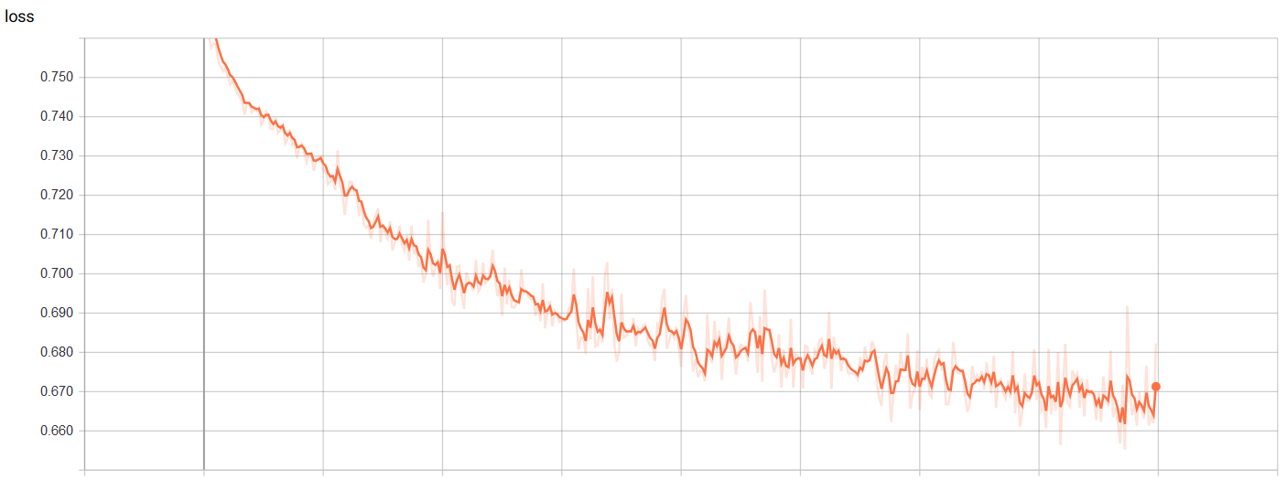
Visualizations (training loss)

Slide 7
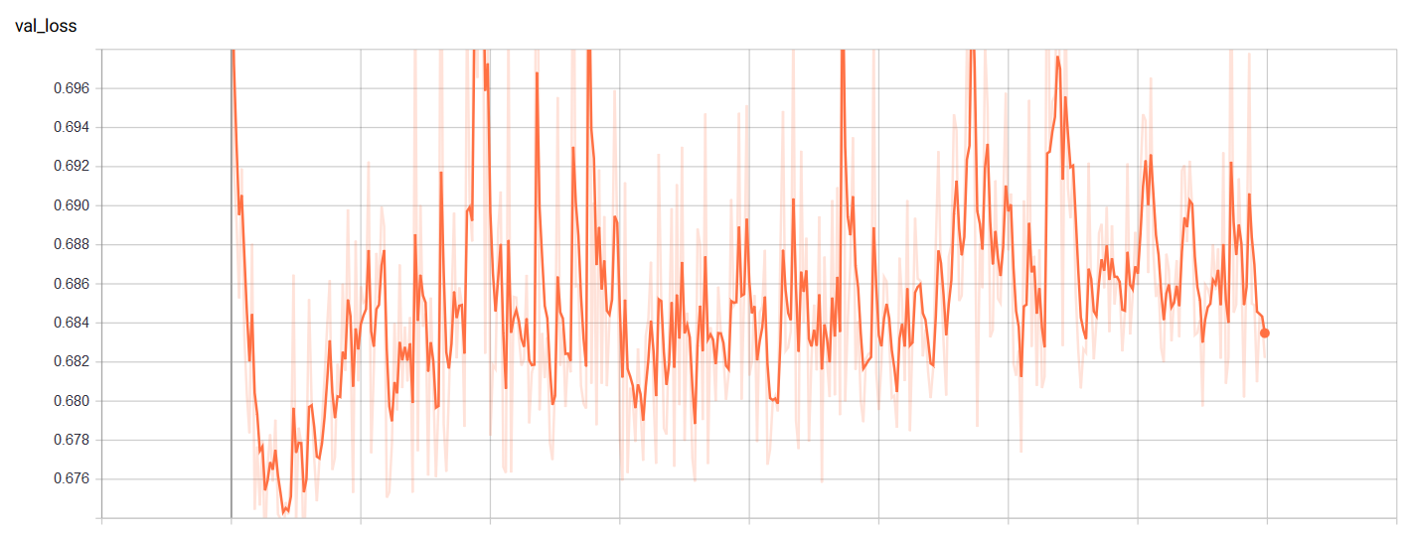
Visualizations (Validation loss)

Slide 8
